Slide 1
Successful Social Entrepreneurship in the Digital Age
Gather Resources…Deliver Value... Generate Participation
Legacy International
Emerging Young Leaders
April 2016
Dr Ira Kaufman
Notes:
Interactive workshop. The PPT is a resource for your future reference and development .
What are the challenges You face as a Social entrepreneur, young professional in address local problems

Slide 2
Workshop Objectives
Provide social entrepreneurs with
10 Step Process to transform a local problem or business challenge into action strategies
Strategic mindset to accomplish your goals
Tools to generate Value for your target audience
Resources to develop you next campaign
Exemplary campaigns from around the world

Slide 3
What are your biggest challenges with your local projects?

Slide 4
What is a World Class Leader?
Pioneering requires vision , risk-taking, self-confidence, comprehensive, challenges status quo and adaptive
Values driven requires humility, mutual respect, transparency willingness to listen and put oneself aside. This consistency in incorporating his/ her values and those of the global digital generation across the organization
Integrated requires agility, flexibility, weaves together diverse resources, and the courage to break down old structures and alter strategies that worked in the past.
Sustainable requires patience, trust, equity, generosity to reformulate the relationships, investments and the impacts that generate sustainable outputs for all stakeholders
Agile requires a continuous approach to innovation in the area of business model generation, customer experience, and talent integration

Slide 5
You bring
Power of your values
Access to your network
Ability to engage
Notes:
PUBLISHER ,,,,,Integrator
Hwow do make na na combining mint, green tea ,and sugar = na na a different drink

Slide 6
To meet your challenges
Be Strategic …riveted on goals
Design … user driven
Execute … efficiently, quickly
Implement collaboratively
Innovate continuously, listen

Slide 7
What's my approach?
To ignite and synthesize 4 elements
Your core values
Your network
Strategic marketing
Integrated digital strategies
By integrating tactics you bring a new power, clarity and direction to your projects

Slide 8
10 steps to action
1. Create business model
2. Define the problem
3. Outline the solution
4. Select your targets
5. Develop value proposition
6. Target stage of customer involvement cycle
7. Create brand message
8. Define Call to Action (CTA)
9. Determine your channels
10. Allocate media mix

Slide 9
Define your Challenge… Choose your Problem
Moroccan Petites Bonnes or
“little maids”
End Child Labor… Slavery
168 million child workers globally

Slide 10
Step #1
Transform your problem, challenge, opportunity into a business model
Notes:
Ten steps to developing a campaign plan.
Developing actionable strategies that achieve organization's goals

Slide 11
What is an organizational/business model?
Club, Group
Campaign
Non profit
Non Governmental
Organization
Social Business
Social Enterprise (profit)
How are you going to organize, deliver your message and create action?
Notes:
Social business- all excess funds dedicated to further cause
Goals of enterprise --3 Ps people profit and planet

Slide 12
Global Digital Landscape
New Business Models

Slide 13
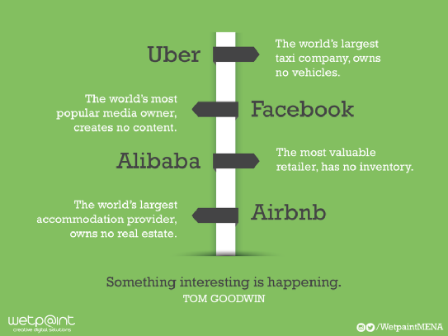

Slide 14
Lean canvas… the snapshot
https://www.youtube.com/watch?v=7o8uYdUaFR4
Notes:
Snap shot of a path to define your problem and your Value and achieve your goals

Slide 15
Marketing Roadmap

Slide 16
Creating Shared Value
creating measurable business value by investing in social problems that intersect with their business.
generating sustainable outcomes for all stakeholders- consumer, employee, partner, community and investor

Slide 17
https://www.youtube.com/watch?v=1vK3cxnP6I4

Slide 18
GROUP INPUT #2. What is the Problem? Task: (3) one line statements summarizing the video
What the video is trying to communicate?
Define the problem(s)
Note:
Why was the message said in this way?
Look for little words that communicate “big concepts”
What are their values ?
Look for gaps, OPPORTUNTIES TO ADDRESS THE PROBLEM

Slide 19
https://www.youtube.com/watch?v=Q_b3RFRBrLw
Educational International --Child labor Morocco
Excerpts; 0-500
Notes:
Problems
1. Desperate Poor families need $ for survival
Don’t know of any alternative
Need school teacher outreach support
Abuse of children
Accepted practice among class of society
Where to put the pressure in the system
Work environment unkind
Little words gig concepts
Child slave
Abuse
In equality
Transparency in society
what video saying
Survival
to put smart child in bondage against her will

Slide 20
GROUP INPUT #3 What is the Solution?
Goal(s) of the campaign
Top three features

Slide 21
GROUP INPUT #4Task: Who are their Targets?
Who was the video directed?
Who is the program directed?
Low hanging fruit
Early adopters vs laggards
Notes:
Video is in English
Moroccan Teachers
donors
partner agencies

Slide 22
GROUP INPUT #5: What is the Value Proposition?
Clear compelling promise of value to be delivered.
explains how your service solves your targets‘ problems or improves their situation
delivers specific benefits
tells the ideal target why they should participate

Slide 23
Value proposition Task: Articulate in one sentence- 20-30 words
Describe why people should participate (volunteer, contribute) in this service.
What service do you provide?
Who are your targets?
Why your offering is unique and different?
What are the end-benefit/expected improvements?

Slide 24
#6
What stage are you targeting?
Customer Journey Involvement Cycle
Think involvement, movement and sustainability; not results
CX drives movement
Notes:
Many social campaigns are awareness; difficult to switch them in mid stream
Move user through tnhe cycle depends on CX causes sustaible change
Mots orgaizations stop at commitemmnet / conversions
Real success is post commitment fostering UGC
mobilize champions to spread your message leverage their networks

Slide 25
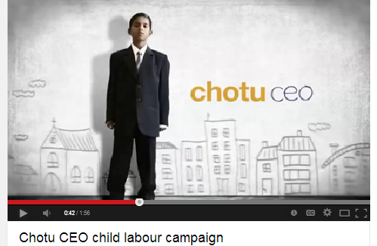
#7 What's your Brand Messaging
Brand essence
Brand properties (3 features)
Value proposition
Unfair advantage
Compelling content
https://www.youtube.com/watch?v=PZoO67l90ns

Slide 26
#8 Call to Action …sale, participate, donate
Make you ask :
Project your message clearly –
in the subject line or first paragraph.
Simple to execute.
Solid, define the need.
Create value and impact.
Generate worth/ benefit for your community.

Slide 27
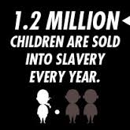

Slide 28
What strikes you ?
https://www.youtube.com/watch?v=ogxCVRVDhCM

Slide 29
#9 What are the Channels? Path to your targets
Outbound--pushes service to consumer via one way media (e.g., TV , radio, billboards , advertisements)
Inbound-- focuses on earning, not buying, a person's attention via two-way dialogue (e.g., social media, mobile technologies, engaging content)

Slide 30
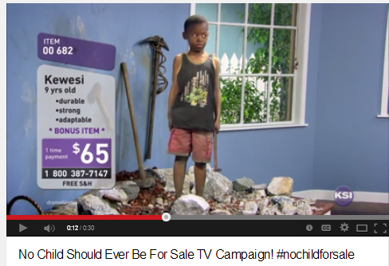
30 sec TV Public Service announcement Kewesi for Sale !
https://www.youtube.com/watch?v=lgEFxcKOYIM

Slide 31
Crowdsourcing Mobile app
3,800 incidents
reported 3 yrs
https://www.youtube.com/watch?v=sdCcUH1vFkM
http://www.thinkwithgoogle.com/campaigns/fundacion-telefonica-kid-rescue.html

Slide 32
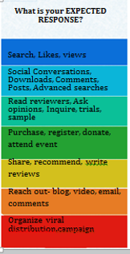
#10 What media drives ongoing involvement ?
Digital Involvement Funnel | Tools
Awareness | Email, Banner Ads, QR Codes, Foursquare
Interest Facebook, Twitter, Pinterest, Social Contests
Involvement YouTube, Blogs, Newsletter,
Commitment Coupons, Social Buzz, Opt-ins, Calls-to-Action
Loyalty Social Customer Relationship Management
Advocacy Share Buttons, Referral Links
Championing Access Social, Network Community, Surveys

Slide 34
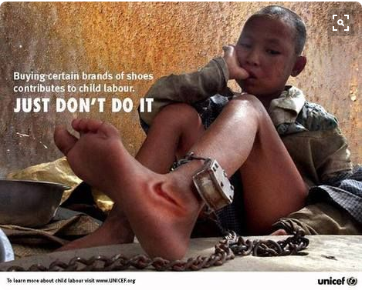
Social media attacks child slavery
Hashtag #endchildslavery –Unicef
Twitter lime app China used to find missing children
End of supply chain- Hershey buts fair trade chocolate after massive campaign by chage.org
Pinterest, Instagram drive photos
Snapchat – recruitment volunteers, gain awareness , drive website

Slide 35
Whats app –Unutilized capacity of an app?
class room interactions –teacher students
College admission dialogue
Announce class quizzes
Group chat – hot line
Free – low bandwidth – easy access via mobile

Slide 36
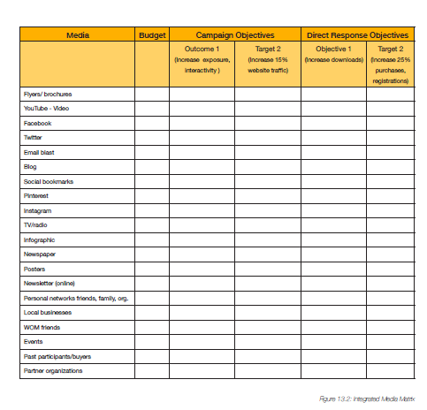
Integrated Media Matrix

Slide 37
Traditional Media "Red Card" -intl football games advocacy campaigns raise awareness to prevent child labour

Slide 38
Augmented reality
Download app zappar.com ,
hover over zapcode
https://www.youtube.com/watch?v=4J1sYC3zM2c 3gDS

Slide 39
CROWDFUNDING
-raising small amounts of money that is given to entrepreneurs from large number of people ( e.g., friends, acquaintances, and the general Internet crowd) who are interested in what they're doing.
Shift mindsets and realities around organizational possibility
Democratizes participation in funding
Foster communities and networks of creators and new donors , and business models

Slide 40
Integrated Digital # nochildforsale
https://www.youtube.com/watch?v=4J1sYC3zM2c

Slide 41
GROUP INPUT Visualize…Project Future Child Labor Campaign in Morocco
What would you change ?
Design strategy for Child Labor campaign in Morocco
Provide marketing rationale for each design decision

Slide 42
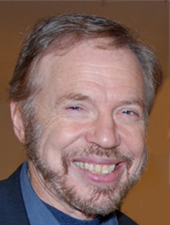
About the Presenter
Dr. Ira Kaufman. Digital Strategist, Social Entrepreneur, Author
Ira combines 30 years of rich experiences with businesses and non-profits to guide them to leverage the power of social media for marketing, recruitment and organizational development. Ira collaborates with a team of experts to design interactive environments to by integrating traditional advertising, online marketing, public relations and social media. His strong values and sensitivity to organization innovation and change are the foundation of his work. Ira has a PhD in Marketing and serves as a consultant, public speaker, and lecturer for companies and Senior Executive programs. He is a member of Legacy International's Teams of Excellence and guides the development of Legacy International Ventures. Currently he is CEO, Entwine Digital; Assistant Professor, Lynchburg College School of Business and Economics.
LinkedIn: http://www.linkedin.com/in/irakaufman
Facebook: http://facebook.com/irakaufman
Twitter: http://twitter.com/ira9201
ira@entwinedigital.com

